Slide 1
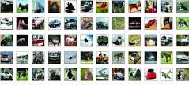
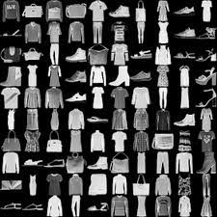
ST1504: Deep Learning CA1
CIFAR-10 & Fashion MNIST
Image
Classification
Ang Kah Shin
P2004176
DAAA/FT/2B/04

Slide 2


Contents
Problem Statement & Methadology
Background Information
Feature Engineering & Image Augmentation
Model Architecture
Conclusions & Recommendations

Slide 3
Image Classification task using CNN

Slide 4
Fashion MNIST Dataset
The Fashion MNIST dataset is a standard image classification dataset used in Computer Vision and Deep Learning comprising of 60000 small square 28 by 28 greyscale images of 10 types of clothing
CIFAR-10 Dataset
The CIFAR-10 Dataset consists of 60000 32 by 32 colour images in 10 classes. The dataset is divided into five training batches and one test batch, each with 10000 images.

Slide 5
Fashion MNIST Dataset
Step 1
Step 2
Step 3
Step 4
Reshape each image to be shape (28x28x1)
Data Augmentation using Image Data Generator
Normalize the image pixel values to be between 0 and 1
Encode label data (y_train and y_test)
CIFAR-10 Dataset
Step 1
Step 2
Step 3
Step 4
Flatten label dataset
Data Augmentation using Image Data Generator
Normalize the image pixel values to be between 0 and 1
Encode label data (y_train and y_test)

Slide 6
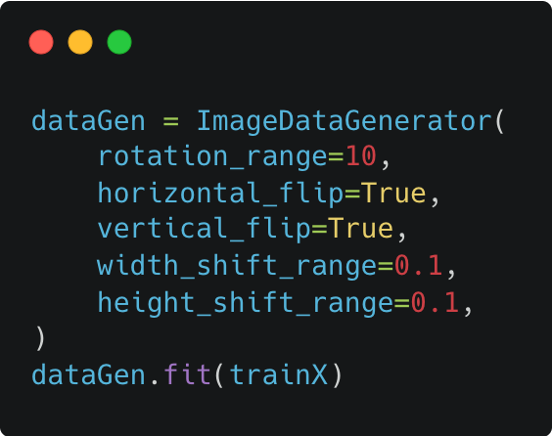
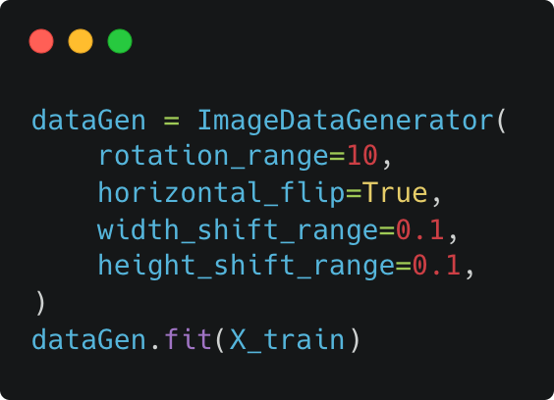
Feature Engineering
Fashion MNIST
CIFAR-10

Slide 7
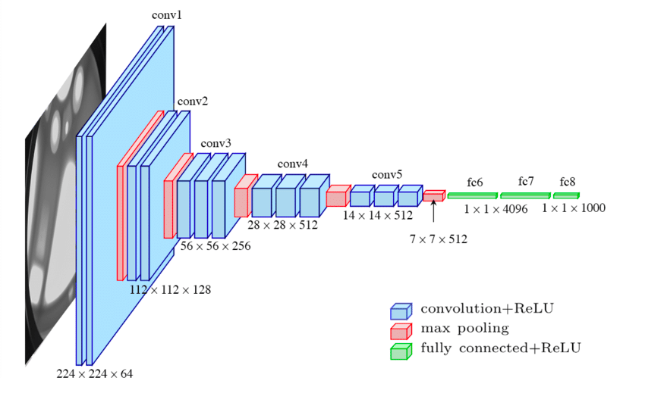
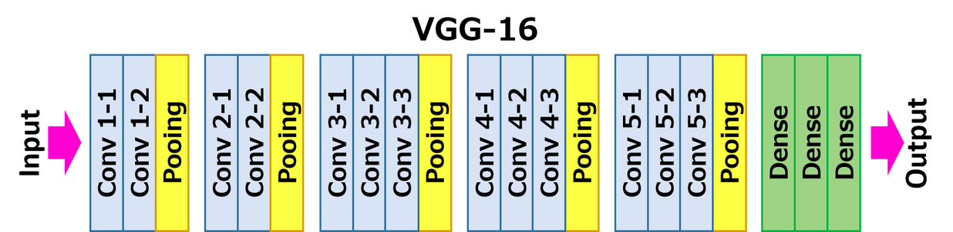
Modified VGG-16

Slide 8
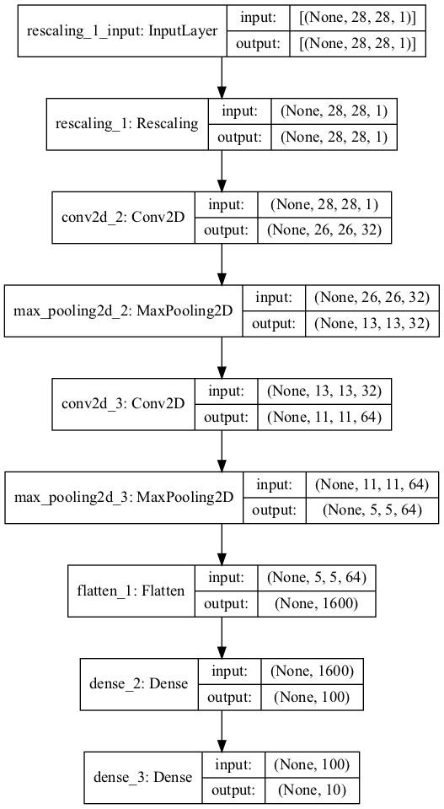
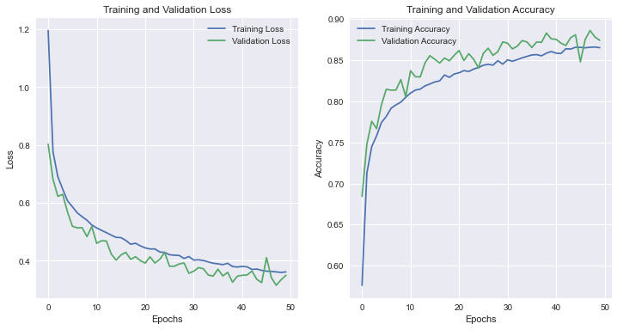
Baseline Model for
Fashion MNIST

Slide 9
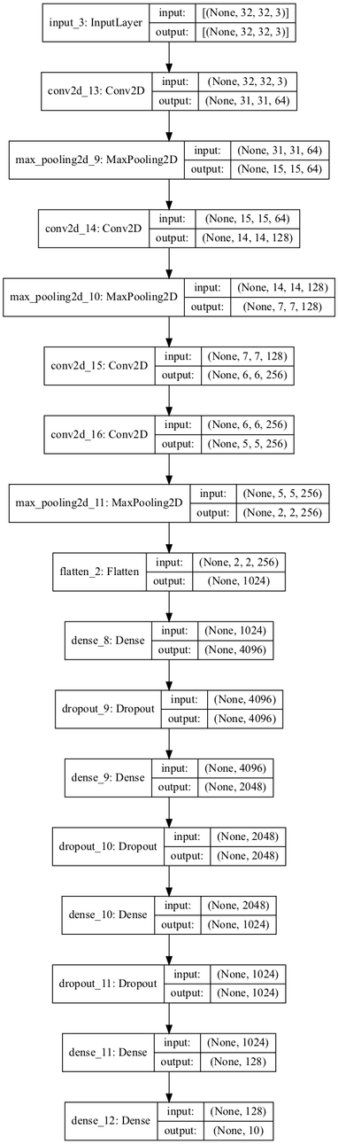
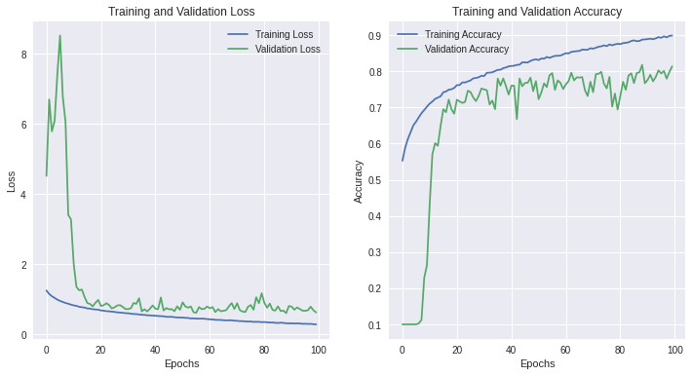
Baseline Model for
CIFAR-10

Slide 10
Limitations of Traditional VGG16
Too many Layers
Long Training time per epoch
Too many Parameters

Slide 11
Model Improvement

Slide 12
Fashion MNIST: Modified VGG-07
Increased Convolution layers from base model
(7 layers)
Added Batch Normalization after every 2 Convolution blocks

Slide 13
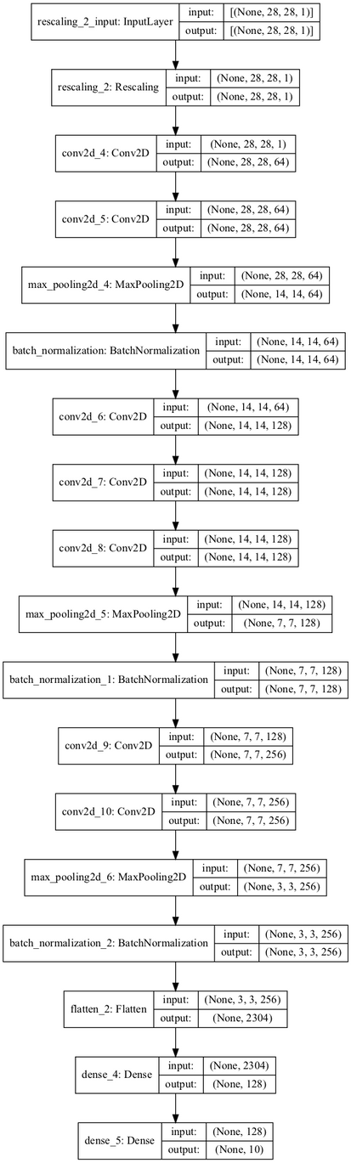
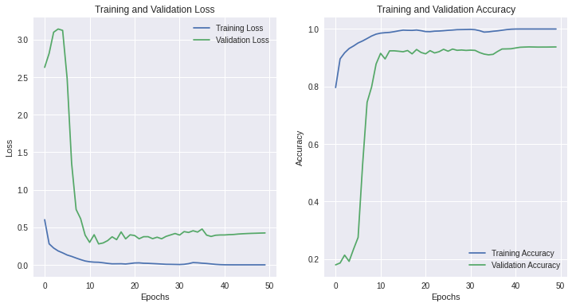
Fashion MNIST: Modified VGG-07
Accuracy: 93.7%

Slide 14
CIFAR-10:
Modified VGG-13
Increased Convolution layers from base model
(13 layers)
Added Batch Normalization after every 2 Convolution blocks
Replaced multiple Dense layers with
a single Global Average Pooling
Added Reduce Learning Rate on Plateau on model callbacks

Slide 15
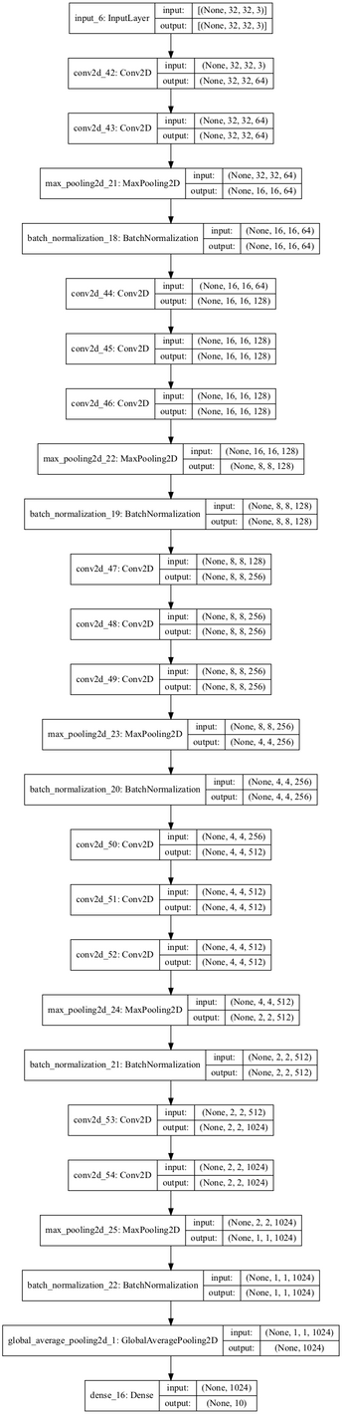
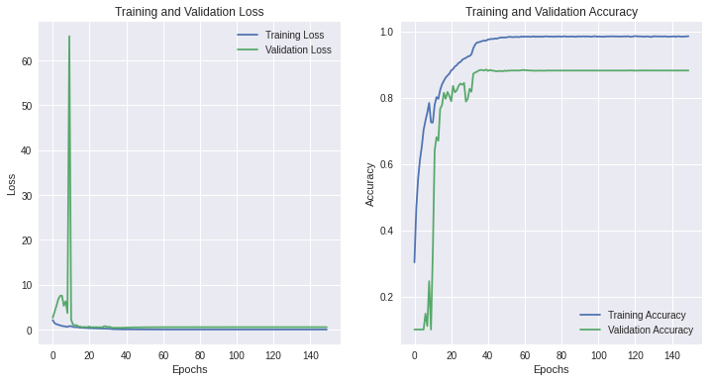
CIFAR-10:
Modified VGG-13
Accuracy: 88.3%

Slide 16
Conclusion
Global Average Pooling > Dense Layers
Deeper Neural Networks
does not mean better Networks

